Slide 1




AMRIT CAMPUS
AFFILIATED TO TRIBHUVAN UNIVERSITY
CROP RECOMMENDATION SYSTEM
WITH INTEGRATED CROP CURE AND MARKETPLACE
By
Ashish Khatri 23123/076
Kritan Sitaula 23149/076
Nischal Kafle 23165/076
Under the supervision of Mr. Rakesh Kumar Bachchan

Slide 2





Introduction
Crop selection
01.
An effort to solve agricultural problem with a robust software solution
02.
Comprises of three major subsystem to provide help in a complete crop cycle
03.
Use of Random Forest Classifier for data driven decision making
04.
Highly Beneficial for farmer and consumer
Plant care
Online Marketplace

Slide 3


Problem Statement
Lack of expertise on crop selection, lack of expertise during cultivation and lack of online platform for selling agro products are some problems in current agriculture scenario.
This projects aims to solve this issue with unified software solution which can recommend crop based on soil nutrient, recommend crop cure ideas and provide online platform for selling agro products.

Slide 4
Objectives
To digitalize crop selection process
To provide ideas in curing the plant
To develop platform for trading agricultural products.
Crop Recommendation System
Plant Cure Recommendation
E-commerce Functionality

Slide 5



Test Driven Development
Pair Programming
Methodology Used
XP
Programming
Extreme Programming Methodology was adopted
Pair Programming was practiced
Continuous Integration (CI) was done
Test Driven Development (TDD) was practice.
CI

Slide 6


System Design
Crop Recommendation System
Plant cure Recommendation System
Kishan Saathi App
Online Marketplace for Agricultural Products

Slide 7
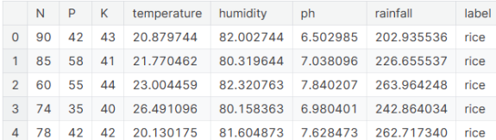
System Design
Random Forest Classfier
CART Algo for decision tree
Dataset of 2200 data
Crop Recommendation System
Data Sample
Plant cure Recommendation System
Online Marketplace for Agricultural Products

Slide 8
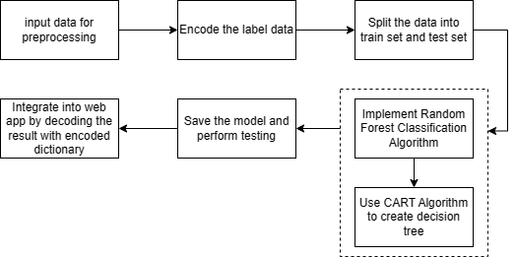
System Design
Flow of Crop Recommendation System
Crop Recommendation System
Plant cure Recommendation System
Online Marketplace for Agricultural Products

Slide 9
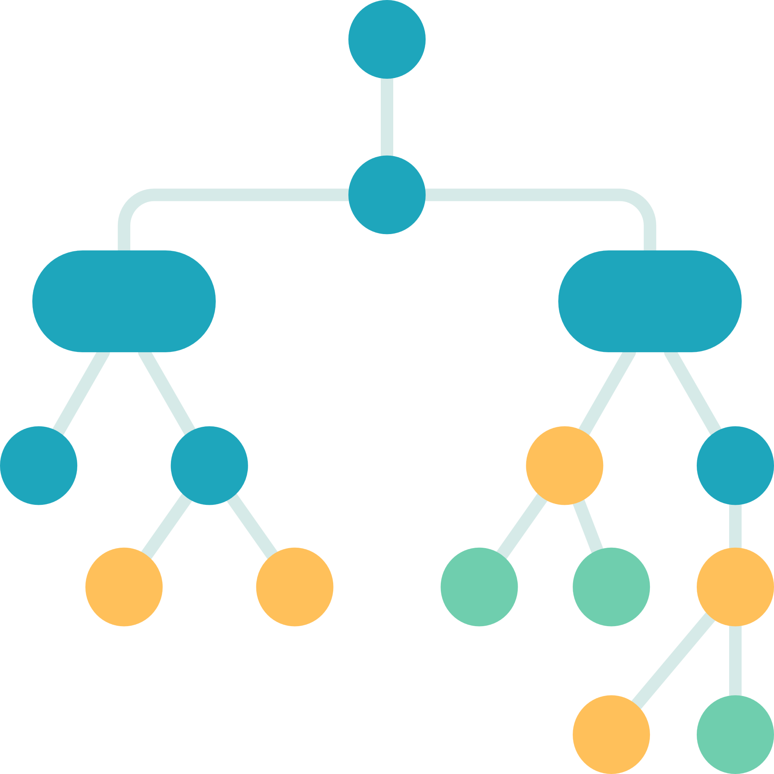

System Design
Random Forest Classifier
Training data instance
Crop Recommendation System
Plant cure Recommendation System
class A
class X
Class X
Online Marketplace for Agricultural Products
Bagging (majority voting)
predicted output
Class X

Slide 10
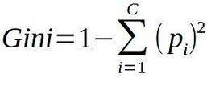
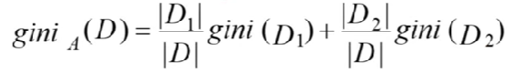
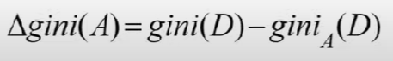
CART Algorithm
Decision Tree made by CART is always binary
System Design
Calculate Gini index of data set
2. Calculate Gini Index of each features
a. For each feature, find a best split of attributes to make two branches of node. To do so, find all possible split. Calculate gini for each possible split. And choose split with less gini as best split
Crop Recommendation System
3. Calculate reduction in impurity to choose the best node.
Plant cure Recommendation System
4. Best node have two edges made up of two attributes. For each edge, take new dataset consisting of that particular attribute and do same to get next node of final class.
Online Marketplace for Agricultural Products

Slide 11
Result Analysis
Crop Recommendation
Crop Recommendation System
K-Fold cross validation was used for performane evaluation
Data were tested against 8 different train-test split percentages. Following result was obtained.
Plant cure Recommendation System
 | 10 | 20 | 30 | 40 | 50 | 60 | 70 | 80
 | 0.9626 | 0.9869 | 0.9870 | 0.9893 | 0.9945 | 0.9931 | 0.9909 | 0.993
train data ratio %
accuracy
Online Marketplace for Agricultural Products

Slide 12
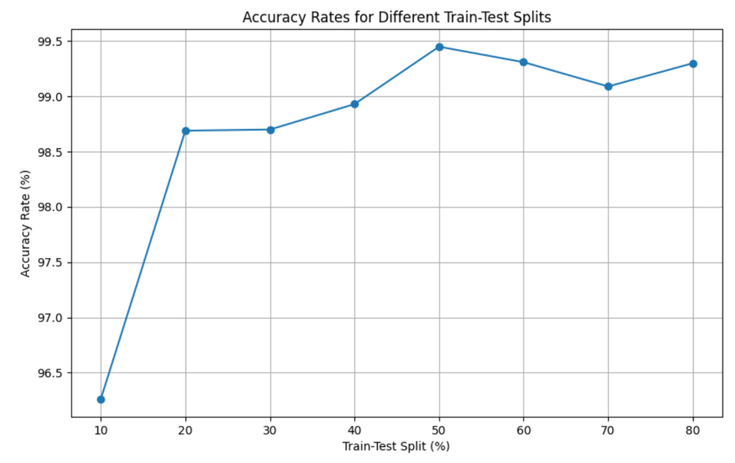
Result Analysis
Crop Recommendation System
Plant cure Recommendation System
Interpretation
Online Marketplace for Agricultural Products
Accuracy consistently improves as the proportion of training data increases
Highest accuracy of 99.45% obtained when using a 50-50 split
Even with smaller training proportions, the algorithm demonstrates robust performance, indicating its effectiveness in predicting suitable crops across different scenarios.
The results suggest that the algorithm can provide reliable crop recommendations with high accuracy

Slide 13
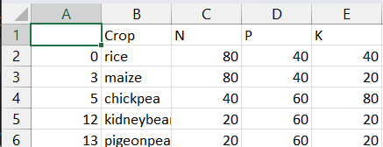
System Design
Cure Recommendation System
Sample data
Crop Recommendation System
Plant cure Recommendation System
Online Marketplace for Agricultural Products

Slide 14
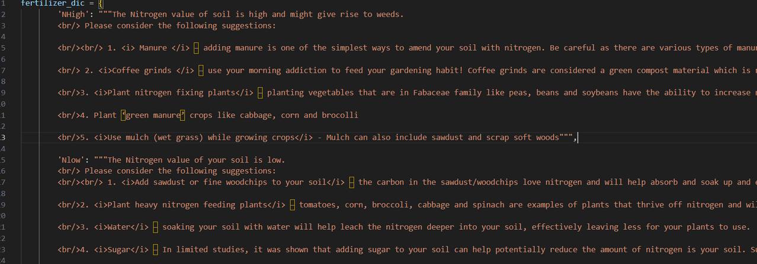
System Design
Flow of Cure Recommendation System
Crop Recommendation System
Compare given N, P, K with dataset and find out which one is adequate or not enough
Based on which one is high or low, show cure recommendation as per in dictionary
Take N, P, K and crop name as input from user
Plant cure Recommendation System
Sample dictionary
Online Marketplace for Agricultural Products

Slide 15







System Design
E-commerce system
Crop Recommendation System
01.
02.
Build with MERN Stack technology
Followed MVC pattern
Plant cure Recommendation System
Online Marketplace for Agricultural Products
03.
Seperation of concern was realized.
04.
Powerful CMS for amazing user experience.

Slide 16
Limitation
01.
Farmer have to manually input soil nutrients data and weather parameter. Sensors could have been implemented to take real time data from farm.
02.
System can only predict 22 different crops. Model could have been trained in larger dataset in order to make more diverse prediction.
03.
Cure recommendations is only based on N, P, K high or low. Other parameters such as pH, micronutrients, climate, etc also should have been taken under consideration.
04.
E-commerce functionality could have been equipped with advance recommendations system like collaborative filtering, content based filtering, etc.

Slide 17

PROJECT DEMO
RUN CROP RECOMMENDATION SYSTEM WITH CROP CURE AND ECOMMERCE

Slide 18
THANK YOU
CROP RECOMMENDATION SYSTEM WITH CROP CURE AND ECOMMERCE
ANY QUESTIONS?

